Slide 1
The Silk Road
Coding Project By: Christopher Khoshaba, Christian Ramirez Gomez, Joel Koreth, and Will Davidson

Slide 2
Game Description
Turn-based game based off of the history of the Silk Road
Players play as a merchant from one of three empires: Roman, Parthain and Han empires
Players can travel to each empire and trade recourse and gold
As the player travels random events can occur that can alter the status of the player
The player will have 20 turns to try to get as much gold and resources as they can

Slide 3
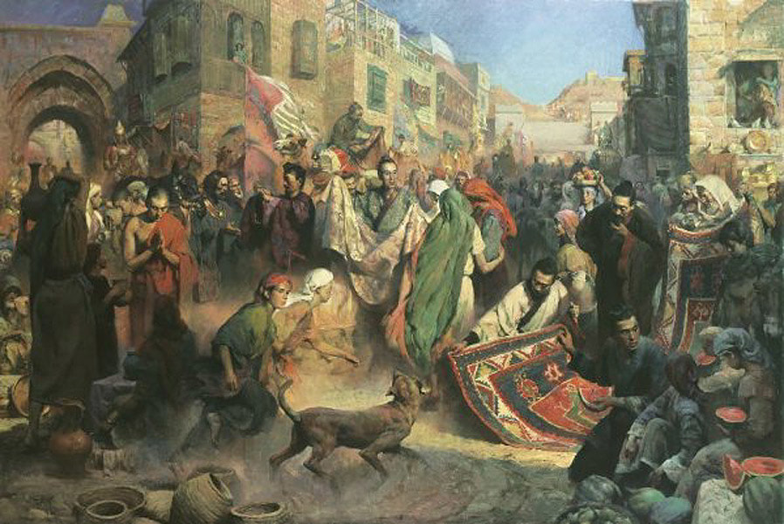
Trade System - Functionality
Once a player enters a city they can buy and sell a inputted amount of goods
Prices vary depending on the city
Some player bonuses could affect the gold exchange rate
Events can also affect the prices in each City

Slide 4
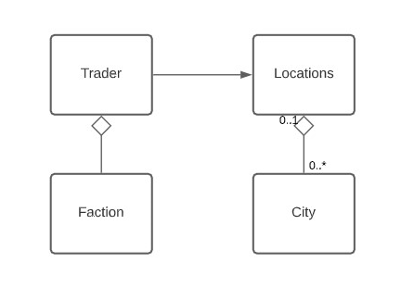
Trade System - Implementation
Locations Class
Loads the City file with the buyable and sellable goods with the price for each
City Class
Collection of cities stored in Location
Trader Class
Keeps an inventory tracking purchased goods
Handles Buying and selling from Cities
Faction
Information for starting city and bonus

Slide 5
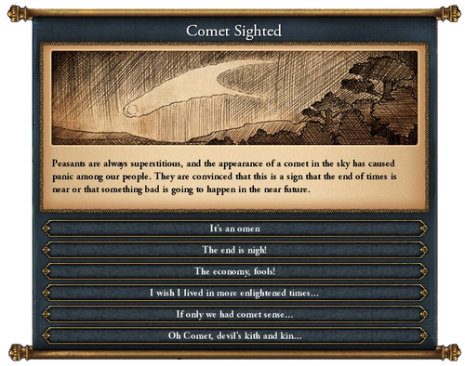
Event System - The Inspiration and Description
Inspired by Grand Strategy Game Europa Universalis IV.
From the top down, these events would offer an event title, image, description, and numerous options.
Each option would have its own effect; however, this example events actually had the same outcome for every event, as it is meant to be funny.
Random System, events are not guaranteed to occur.

Slide 6
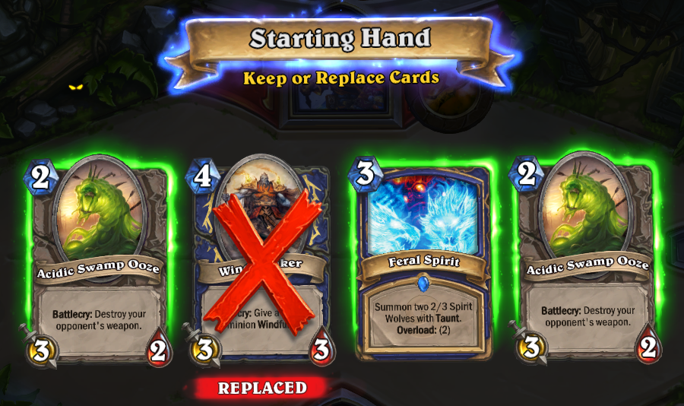
Event System - The Purpose
To Create a Unique Experience Each Game.
Like how Hearthstone’s random draws keep games fresh.
To Prevent a Strategy from Becoming Dominant Every Game.
A sequential game like ours would could simply be solved by applying Game Theory Statistics like backwards induction; however, RNG prevents this from occurring.
To Encourage Players to analyze the situation and play according rather than following a predefined strategy.

Slide 7
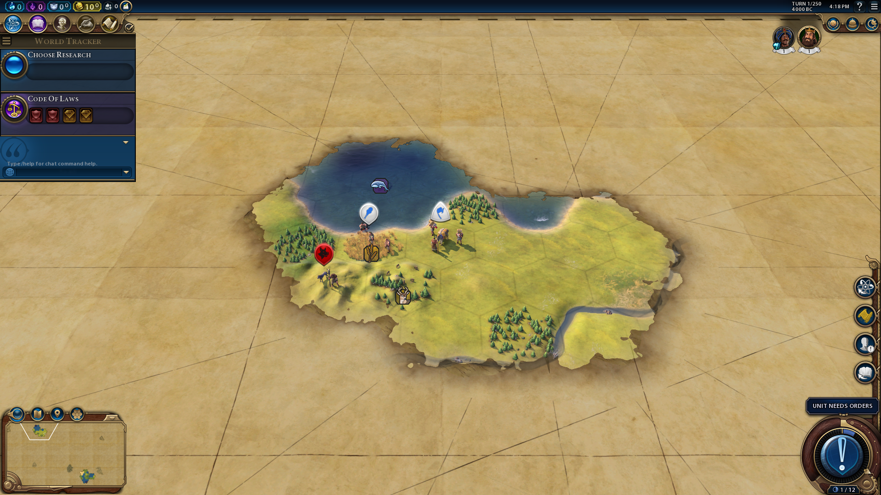
Event System - The Issues and Solutions
RNG Systems can feel unfair.
Global events that impact everyone.
RNG Systems can create situations where the player had little to no chance to prepare.
Set restrictions on events, so players can always prepare. In the Silk Route, bandit attacks may only occur past turn 10 for example.

Slide 8
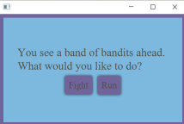
Event System - Our Implementation
Generate random numbers
Distribute these random numbers to events.
Those events occur on those turn numbers.
Add in additional restrictions: No Bandit Attacks until after turn 10
Give Description of Event
Give Choices: Fight or Run for example

Slide 9
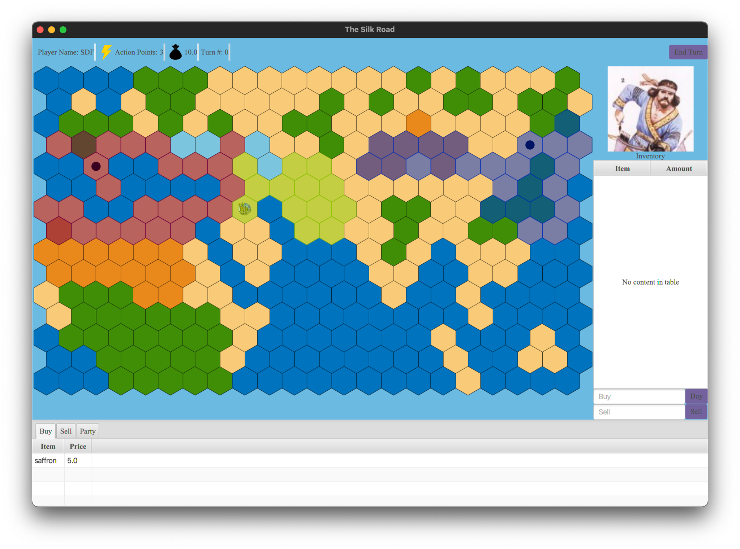
Map - Formulation
We aimed at implementing an hexagonally tiled map
Advantages
Equidistant movement from tile to tile
Disadvantages
Additional Complexity
Loss of 2 directional movements

Slide 10
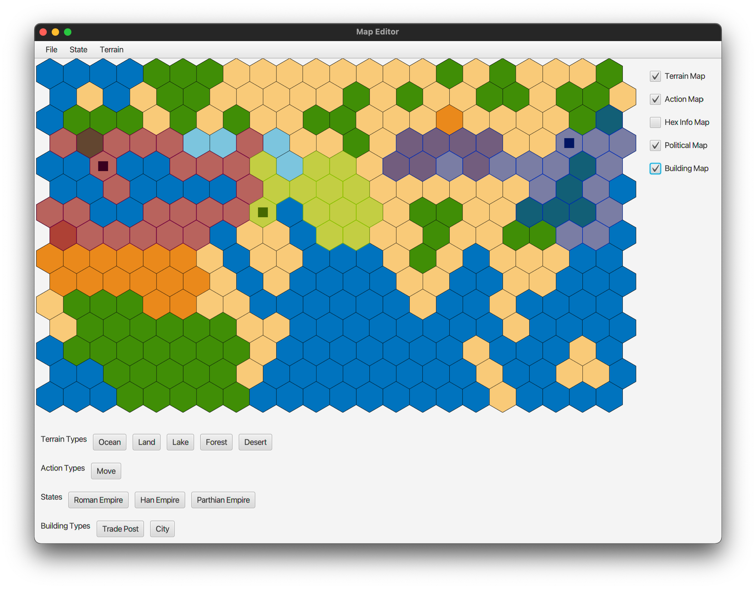
Map - GUI Editor
Development of a GUI Map editor for the game
Features -
Saving and Loading from a binary format
Runtime implementation of custom terrain and states
Debugging features such as movement and tile location.

Slide 11
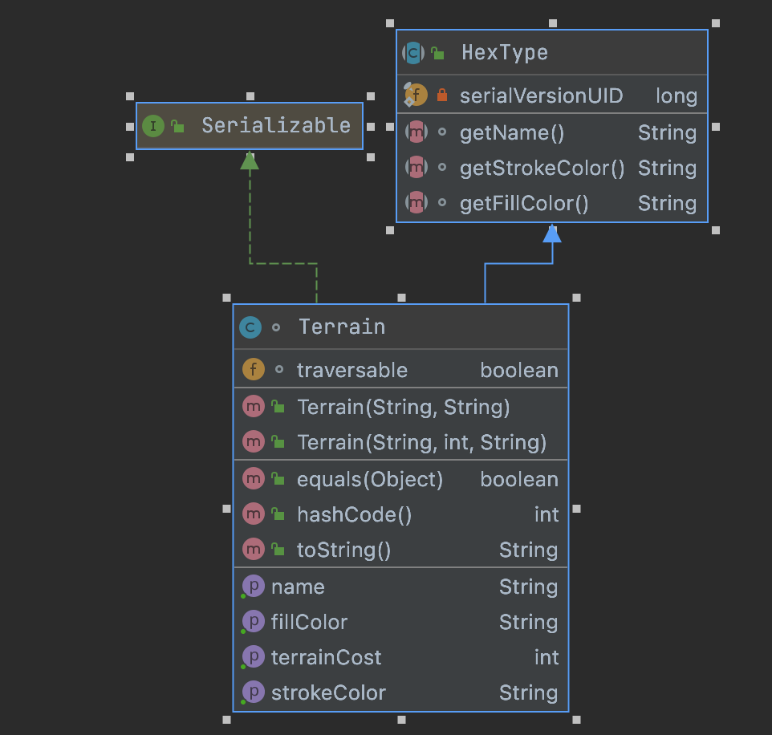
Map - Implementation
Architecture
Each Hexagon is associated with an HexData object in a HashMap
HexData contains HexType Objects
Each class implements Serializable to allow saving the map into a binary format for moving between the editor to the game
Game Map
Multiple layering for opacity
Map is redrawn on any map update

